Slide 1
Overview on DMA Attacks
02NPSOV - Operating Systems For Embedded Systems
Elias Michael - s307276
Marino Lorenzo - s317703
Sansone Giacomo – s307761
Valenza Arianna - s317742

Slide 2
Table of contents
01
03
DMA on LPC1768
DMA and protection
02
04
DMA attacks
Exercises on DMA attacks

Slide 3
DMA and protection
01
What are DMA and memory protection?

Slide 4
What is DMA?
Direct Memory Access:
Direct Memory Access is a feature that allows hardware devices to access the memory directly, independently of the CPU.
Why we want to use it?
Normally, a device read or write data to memory through the CPU.
With DMA, the device can bypass the CPU and access memory directly. This speeds up data transfer and frees up the CPU to perform other tasks.

Slide 5
Where can we find it?
First party DMA
Third party DMA
A.K.A self-DMA, is a type of DMA where the device itself manages the data transfer between its own buffer and the system memory. The device initiates the transfer and controls the data flow without the involvement of the CPU.
First-party DMA is commonly used in devices such as disk drives and network adapters.
A.K.A bus-master DMA, consists of a separate DMA controller that manages the data transfer between a device and system memory.
In this case, the device sends a request to the DMA controller, and the controller performs the transfer.
It is found on several SoC.

Slide 6
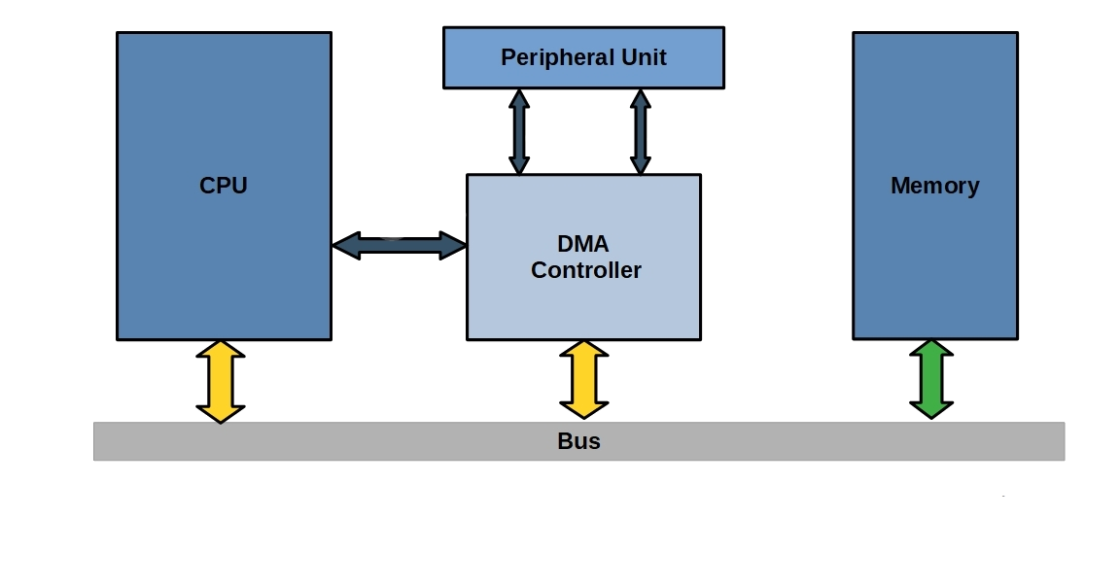
How it works
Device request
Prepare the transfer
Data transfer
The device request a dma trasfer, providing the source/destination physical addresses
DMA controller process the request
Image take from open4tech.com
The DMA controller accesses the system bus and copies the requested data.

Slide 7

What is memory protection?
Memory protection is a feature that protects the system from unauthorized access and modification of system memory (e.g. prevent a process from accessing memory that has not been allocated to it). It is an essential component of computer security and helps to prevent malicious programs from accessing or modifying sensitive data.

Slide 8
How it is implemented
Segmentation
Access control
Virtual memory
The memory is divided in distinct segments, each with its own protection level
A Software mechanism that grants access to memory, based on the user privileges.
Virtual addresses are mapped into physical addresses through an MMU

Slide 9
02
DMA Attacks
Why DMA can be dangerous?

Slide 10
DMA Attacks
Definition
A DMA attack is defined as when an attacker gains access to the victim’s system memory, enabling him to read/write from/to the memory bypassing the system’s CPU
Characteristics
DMA attacks are easier to implement on embedded systems than on general purpose computer. After the DMA is set, data transfers can be done without the aid of neither the CPU nor the operating system.

Slide 11
Example of DMA attacks
Access and/or modify reserved information
Extend control over the kernel itself
Malware injection

Slide 12
Countermeasures
Using an IOMMU
NX-BIT
ASLR
Secure Boot
It determines whether the content of that page can be used for code execution or not.
It limits the memory addresses accessible by a peripheral
It is a memory-protection technique that randomizes the memory layout.
It is a process that verifies the integrity of the system’s boot process.

Slide 13
DMA on LPC1768
03
Getting start with a DMA of a real SoC

Slide 14
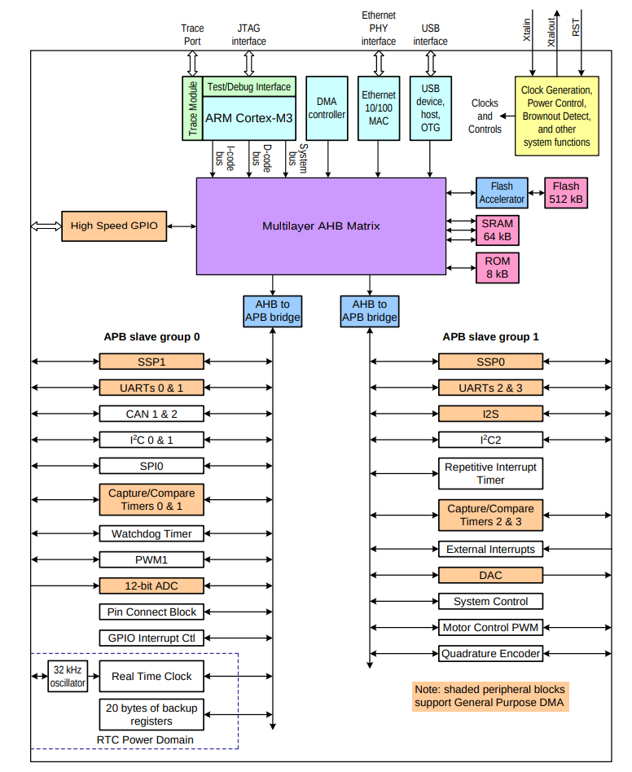
LPC 1768: an SoC
The LPC1768 is a Cortex®-M3 microcontroller for embedded applications.
The DMA controller allows peripheral-to memory, memory-to-peripheral, and memory-to-memory transactions. Each of the 8 DMA stream provides unidirectional serial DMA transfers for a single source and destination. It is highly configurable.
This image comes from the LPC1768 user manual

Slide 15
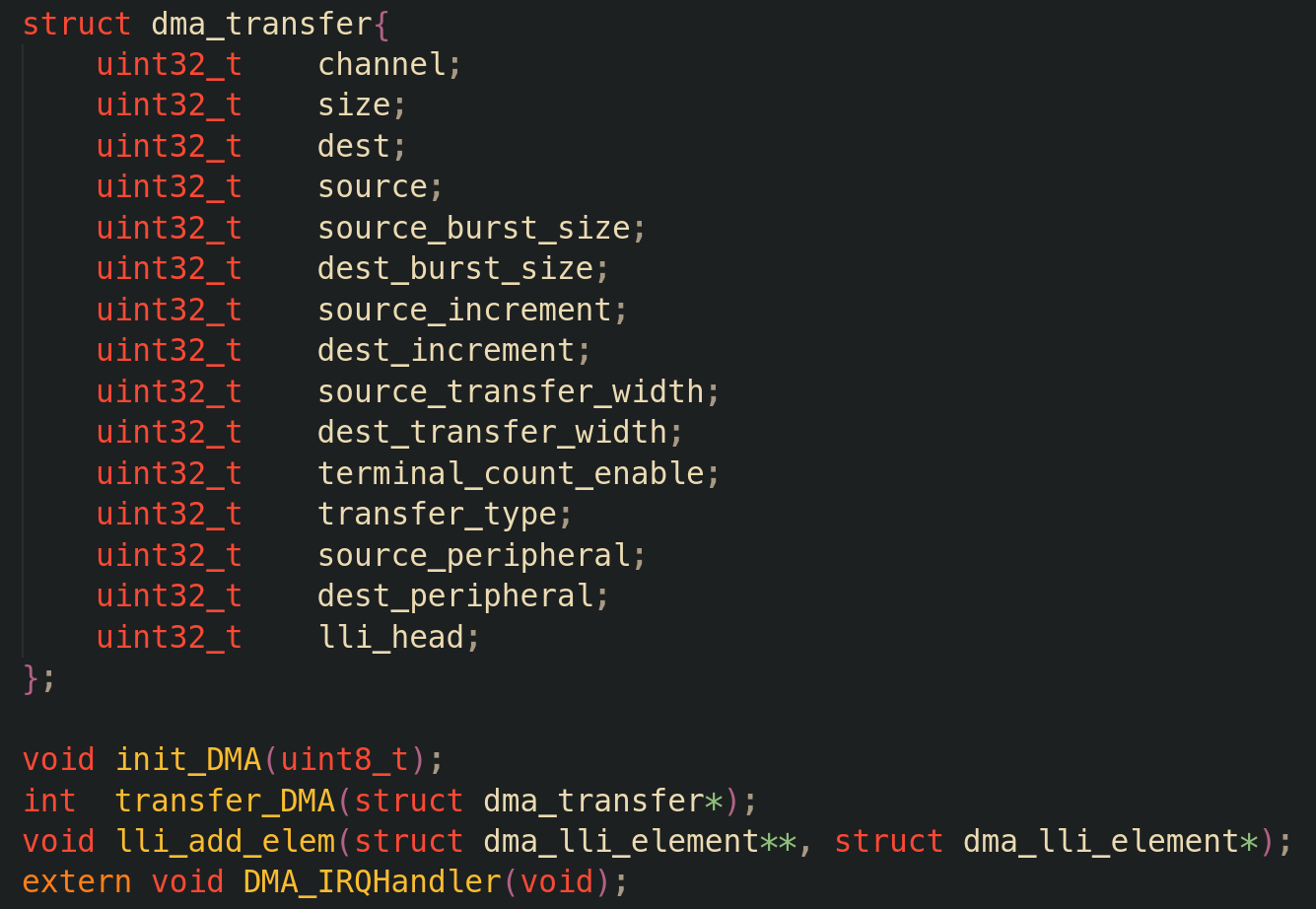
Our DMA library
A DMA transaction requires the GPDMA controller to be initialized using init_DMA. Then, the parameters of the transaction are specified inside an instance of the structure dma_transfer, which is passed as parameter to the transfer_DMA function. This function sets all the registers of the peripheral according to the specification of the user manual of the SOC.

Slide 16
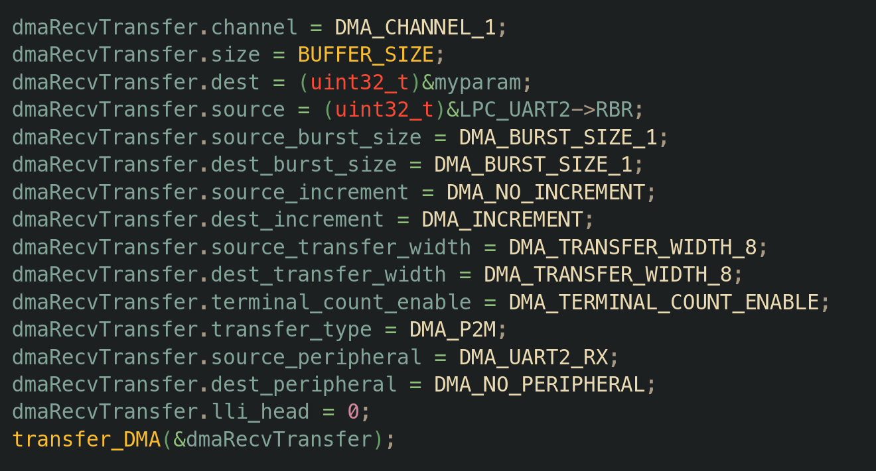
Avoid low-level code!
Since most of the values of the parameters are low-level dependent, we defined many macros to initialize the different elements without the need to look at the user manual. More details about the usage of the library can be found on our documentation. The image below shows and example of initialization, that is self-explained

Slide 17
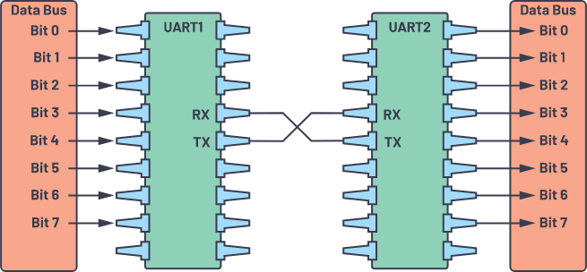
A serial connection
To allow a connection with the board/SoC, we used the UART peripheral. We can send and receive data through a serial terminal on our laptop (PuTTY on Windows, tio on Linux). To do this, we need an RS232-USB cable and to initialize the UART peripheral inside the board. Don't worry, we wrote a library for it as well!
Image take from here

Slide 18
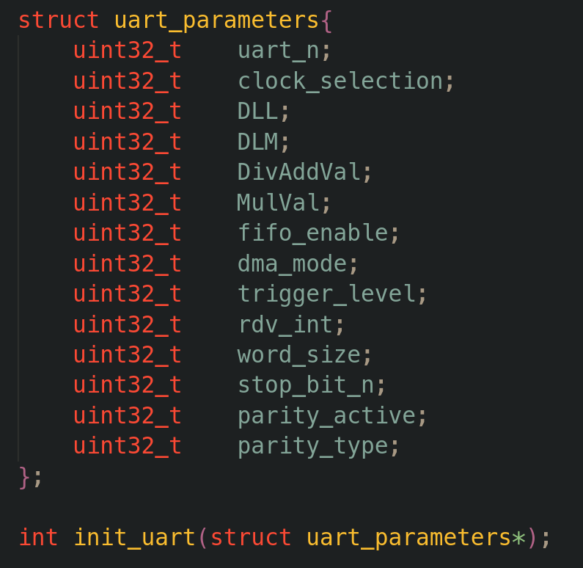
Our UART library
The library is similar to the one for DMA, and its characteristics can be read inside the documentation. We used this peripheral since it allows a direct transfer to memory through DMA: data are sent/received directly without the need of the CPU to handle them.
This allows us to simulate a real transfer from the outside world, and understand how you can modify certain values to hack the system.

Slide 19
04
Exercises on DMA attack
Hands-on exercises

Slide 20
Different purposes
Safety at risk
Steal the password
Break the safety system of the payload of a spacecraft.
Capture the hardcoded password of an embedded system.
Notes:
simulates a DMA attack to the control unit charged to monitor the state of the payload system in a spacecraft.
The aim is to cause the failure of the mission, changing willingly the parameters of the sensors to shut down the on board computer OBC, which cannot operate in particular harsh conditions

Slide 21
Safety at risk/1
Setup
Keil uVision5
PuTTY
LandTiger LPC1768
IDE used to source code editing and program debugging
Terminal Emulator needed to simulate the flow of incoming external data to the board
Physical embedded system connected to host pc through UART connection

Slide 22
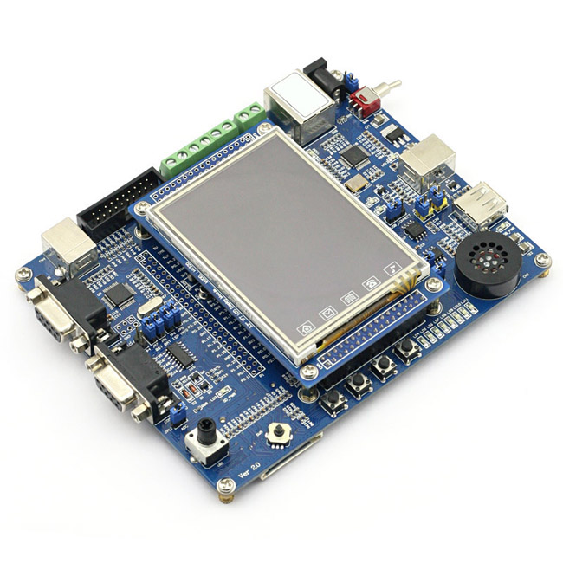
Safety at risk/2
DMA
UART
LCD
The system receives data from sensors over UART and executes operations based on the incoming data.
CRC is applied to the received data and if the condition is not respected actions are not performed.
Direct Memory Access speeds up the data transfer with sensors and permits the DMA attack.
Screen outputs the status of the system continuously.
LandTiger v2.0 LPC1768 (source)
Notes:
3 key peripherals

Slide 23
15th
Hard-coded credentials
Position on 2022 Common Weakness Enumeration (CWE™) Top 25 Most Dangerous Software Weaknesses list
Notes:
Drawn up

Slide 24

Steal the password
Execute a DMA attack to access to critical memory area, using .map file to identify the address.
Steal the password consists in decoding ARM instructions that are used to check if the input password is correct.
LCD will display the receiving buffer of the DMA transfer in hexadecimal.
Source code of the password check is not provided.

Slide 25



This work was possible thanks to Politecnico di Torino and to EMNESS Project

